Slide 1
Predicting Election Results:
2016 Primary Election
Eric Vandament, Jacob Brandis, Eve Dean

Slide 2
About the Dataset
Kaggle dataset of 2016 primary election results
Fraction of votes received per candidate per county
primary election: vote fraction split by party
Missing Minnesota
South Dakota had limited data reported
County facts dataset
Population demographics (age, race, gender)
Economic conditions (median income, percent below poverty, retail sales)

Slide 3
PREDICTING
WINNERS

Slide 4
RACE & ETHNICITY:
Predicting Democratic Primary Outcomes
Input:
% Black (2014)
% Indian American (2014)
% Asian (2014)
% Hawaiian (2014)
% Biracial (2014)
% Hispanic (2014)
% Caucasian (2014)
Can you predict if Hillary Clinton or Bernie Sanders will win in a county based on demographic conditions?
Output:
Predict Clinton win
Predicted
 | Won | Lost
Won | 80.23% | 19.77%
Lost | 21.04% | 78.96%
Actual

Slide 5
RACE & ETHNICITY:
Predicting Republican Primary Outcomes
Input:
% Black (2014)
% Indian American (2014)
% Asian (2014)
% Hawaiian (2014)
% Biracial (2014)
% Hispanic (2014)
% Caucasian (2014)
Can you predict if Donald Trump or Ted Cruz will win in a county based on demographic conditions?
Output:
Predict Clinton win
Predicted
 | Won | Lost
Won | 20.92% | 79.08%
Lost | 2.83% | 97.17%
Actual

Slide 6
GENDER:
Predicting Democratic Primary Outcomes
Input:
% Female (2014)
Output:
Predict Clinton win
Is Hillary Clinton more likely to win in counties with a higher proportion of women?
Predicted
 | Won | Lost
Won | 1.77% | 98.23%
Lost | 3.62% | 96.38%
Actual

Slide 7
PREDICTING NUMBER OF VOTES

Slide 8
DEMOGRAPHIC TRENDS

Slide 9
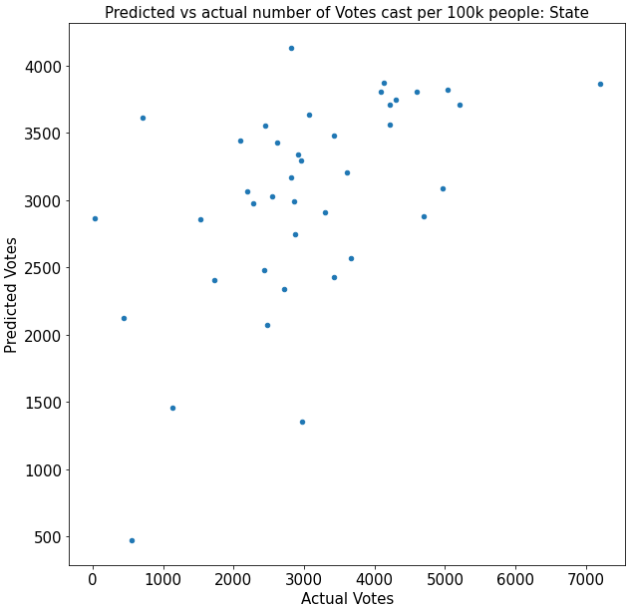
RACE & ETHNICITY:
Predicting number of votes
Can you predict the number of votes cast based on demographic conditions?
MSE = 1460084
R² = 0.2860650364766063

Slide 10
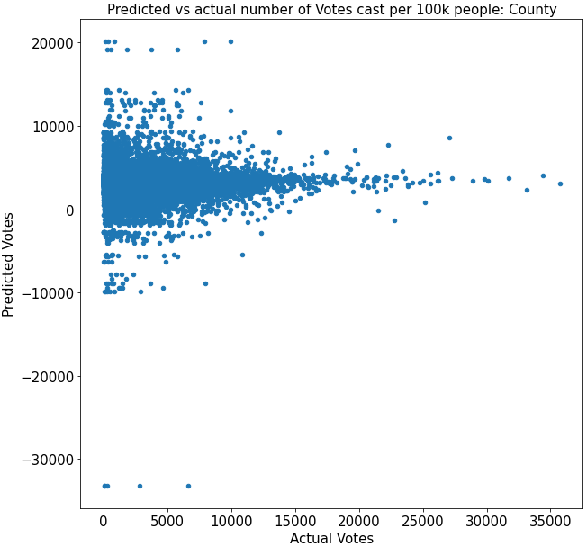
RACE & ETHNICITY:
Predicting number of votes
Can you predict the number of votes cast based on demographic conditions?
MSE = 12614795
R² = -0.24903105036492867

Slide 11
REGIONAL
PREDICTIONS

Slide 12
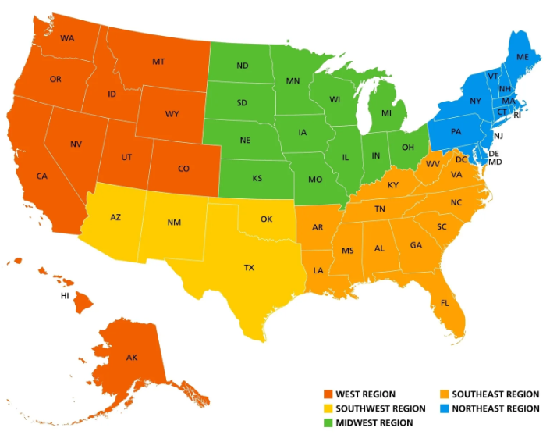
How Do Different Regions Affect Votes?

Slide 13
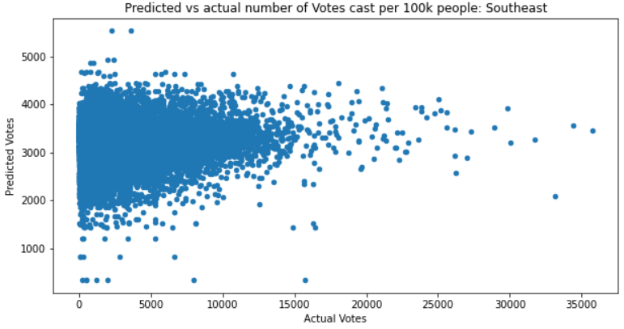
Southeast
Using demographics to predict votes by 100k people
(points represent county)

Slide 14
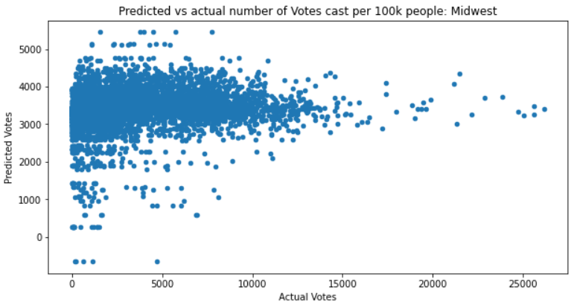
Midwest
Using demographics to predict votes by 100k people
(points represent county)

Slide 15
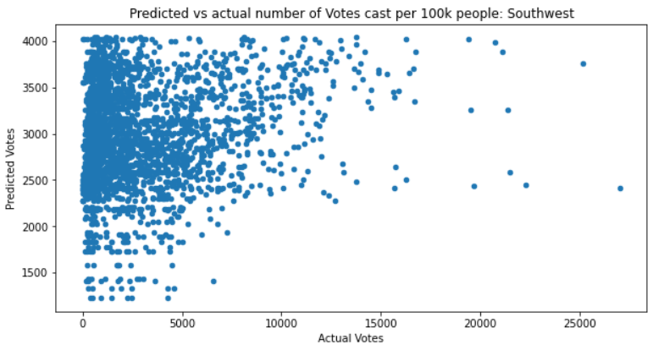
Southwest
Using demographics to predict votes by 100k people
(points represent county)

Slide 16
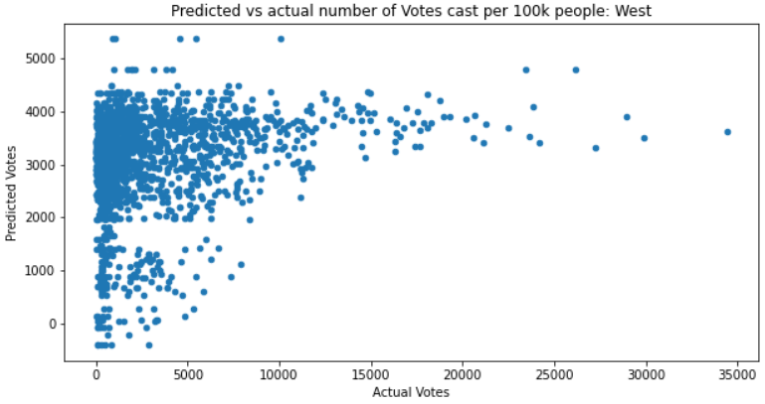
West
Using demographics to predict votes by 100k people
(points represent county)

Slide 17
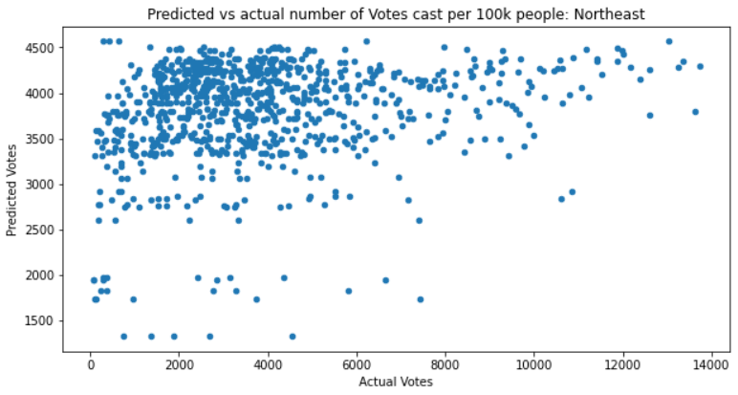
Northeast
High Percentage of White Population
Highest Median Income
Highest Bachelor’s Degree or Higher rate
Highest by Population by Sq. Mile (Insanely High!)
Lowest Poverty Level
Many of the coefficients are high and positive
Using demographics to predict votes by 100k people
(points represent county)

Slide 18
ECONOMIC
PREDICTIONS

Slide 19
Sales:
Predicting number of votes
Columns Used:
Manufacturer shipments by $1000
Merchant wholesaler sales by $1000
Retail Sales by $1000
Food Service Sales by $1000
Grouped by Parties
Democrats Vs. Republicans

Slide 20
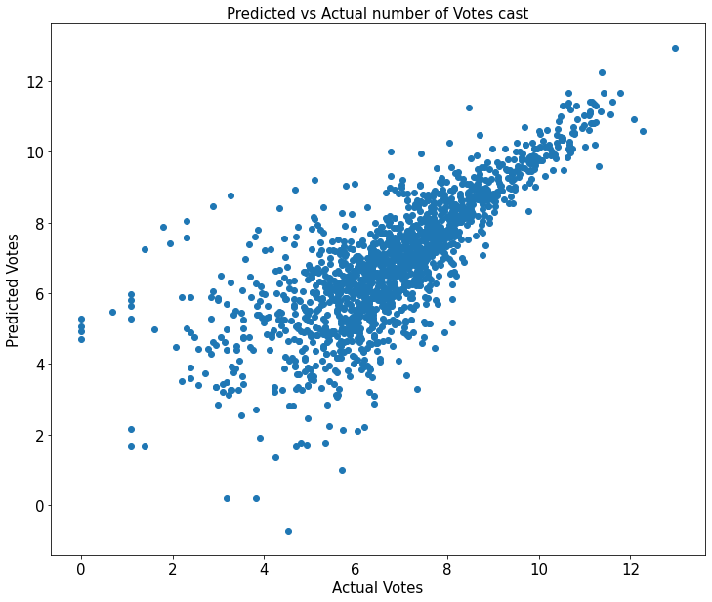
Sales:
Predicting Number of votes Democratic
Democratic candidates see a higher level of correlation
R^2 = 0.771

Slide 21
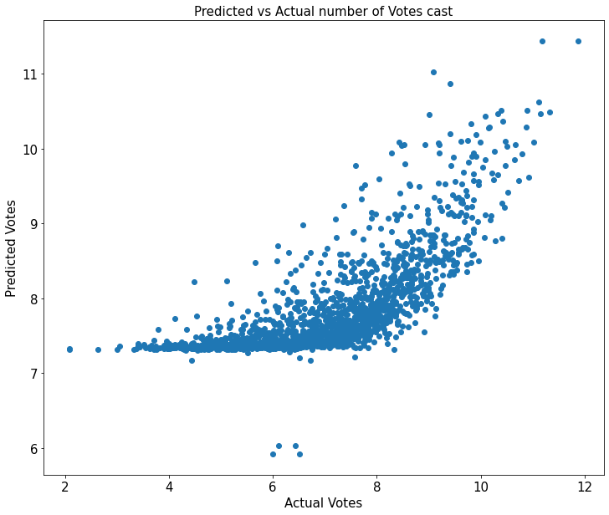
Sales:
Predicting Number of votes Republican
Republican candidates see lower level of correlation than Democrats
R^2 = 0.612

Slide 22
Sales:
Predicting Primary Outcomes With Logistic Regression
Columns Used:
Manufacturer shipments by $1000
Merchant wholesaler sales by $1000
Retail Sales by $1000
Food Service Sales by $1000
Grouped by Parties
Democrats Vs. Republicans

Slide 23
Sales:
Predicting Primary Outcomes With Logistic Regression
Hillary Clinton
Democrats
Percentage of predicted primary elections won for Clinton that are correct
63.02%
Donald Trump
Republicans
Percentage of predicted primary elections won for Trump that are correct
78.01%

Slide 24
USING ALL CONDITIONS

Slide 25
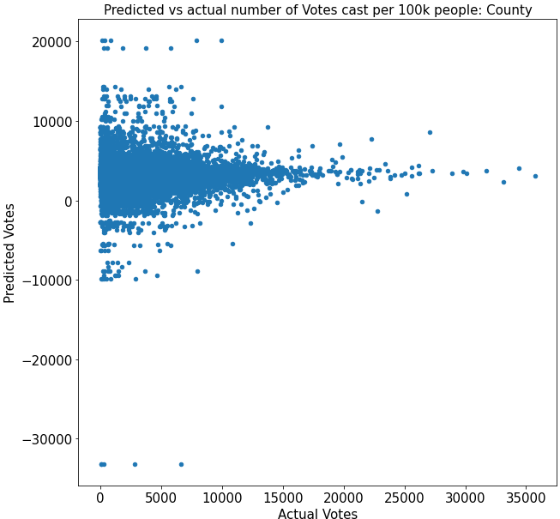
USING ALL CONDITIONS:
Predicting number of votes
Can you predict the number of votes cast based on demographic conditions?
MSE = 12614795
R² = -0.24903105036492867

Slide 26
Conclusions

Slide 27
Conclusions
Voting trends vary by state, county and region
There are a variety of factors involved in election outcomes
Using demographic and economic conditions independently does not make valuable predictions
Using a combination of factors might be more useful, how do you choose which to use?
The Northeast voting patterns when looking at demographic are quite different than the rest of the other regions of the US

